Slide 1
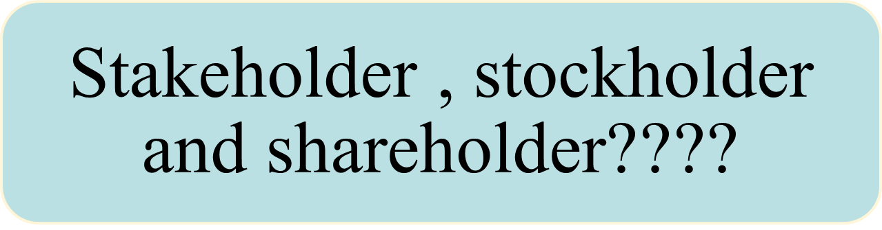
PESTEL ANALYSIS
Chapter 4, Stephen P. Robbins, Mary Coulter, and Nancy Langton, Management, Eighth Canadian Edition.
Copyright © 2005 Pearson Education Canada Inc.

Slide 2
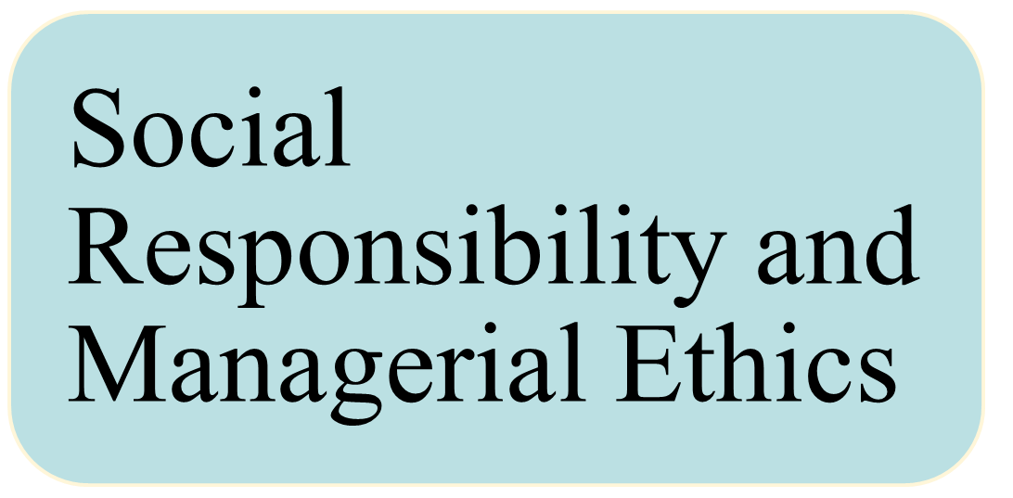
Chapter 4
Chapter 4, Stephen P. Robbins, Mary Coulter, and Nancy Langton, Management, Eighth Canadian Edition.
Copyright © 2005 Pearson Education Canada Inc.

Slide 3

Chapter 4, Stephen P. Robbins, Mary Coulter, and Nancy Langton, Management, Eighth Canadian Edition.
Copyright © 2005 Pearson Education Canada Inc.

Slide 4
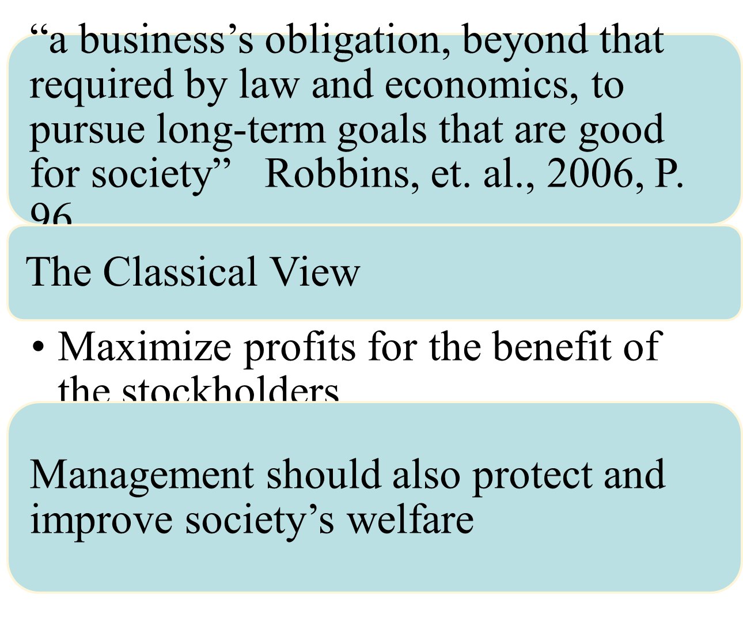
What Is Social Responsibility?
Notes:
Managers regularly face decisions that have a dimension of social responsibility. We define social responsibility as a business’s obligation, beyond that required by law and economics, to pursue long-term goals that are good for society.
This definition assumes that a business obeys laws and pursues economic interests. But also note that this definition views business as a moral agent. That is, in its effort to do good for society, it must differentiate between right and wrong. The more obvious examples include: employee relations, philanthropy, pricing, resource conservation, product quality, and doing business in countries that violate human rights.
There are two opposing views of what social responsibility is.
1. The classical view is the view that management’s only social responsibility is to maximize profits.
a. Milton Friedman is the most outspoken advocate of this view.
b. He argues that managers’ primary responsibility is to operate the business in the best interests of the stockholders—the true owners of the organization.

Slide 5
Exhibit 4.1 Approaches to Social Responsibility
Obstructionist
Defensive
Accommodative
Proactive
Approach
Approach
Approach
Approach
Disregard
Minimal
Moderate
Strong
for social
commitment
commitment
commitment
responsibility
to social
to social
to social
responsibility
responsibility
responsibility
No Social Responsibility
High Social Responsibility
Source: Adapted from S.L. Wartick and P.L. Cochran, “The Evolution of the Corporate Social Performance Model,” Academy of Management Review, October 1985, p. 766.
Chapter 4, Stephen P. Robbins, Mary Coulter, and Nancy Langton, Management, Eighth Canadian Edition.
Copyright © 2005 Pearson Education Canada Inc.
Notes:
A. Obstructionist approach: avoids social responsibility. Obstructionist managers engage in unethical and illegal behaviour, and try to hide their behaviour from organizational stakeholders and society at large.
B. Defensive approach: minimal socially responsible position. These organizations have a commitment to ethical behaviour, making sure that employees behave legally and no harm is done to others. The claims and interests of shareholders come first with this approach, and little attention is paid to other stakeholders.
C. Accommodative approach: going beyond legal requirements, choosing to support social responsibility in a balanced fashion. Accommodative managers try to balance the interests of shareholders with those of other stakeholders by making choices that appear reasonable to all members of society.
D. Proactive approach: finds out about and meets the needs of different stakeholder groups. Promotes the interests of stockholders, shareholders, and stakeholders, using organizational resources to do so. These managers feel a responsibility to society as a whole.
The defensive approach is consistent with the classical view, while the accommodative and proactive approaches are consistent with the socio-economic view.

Slide 6
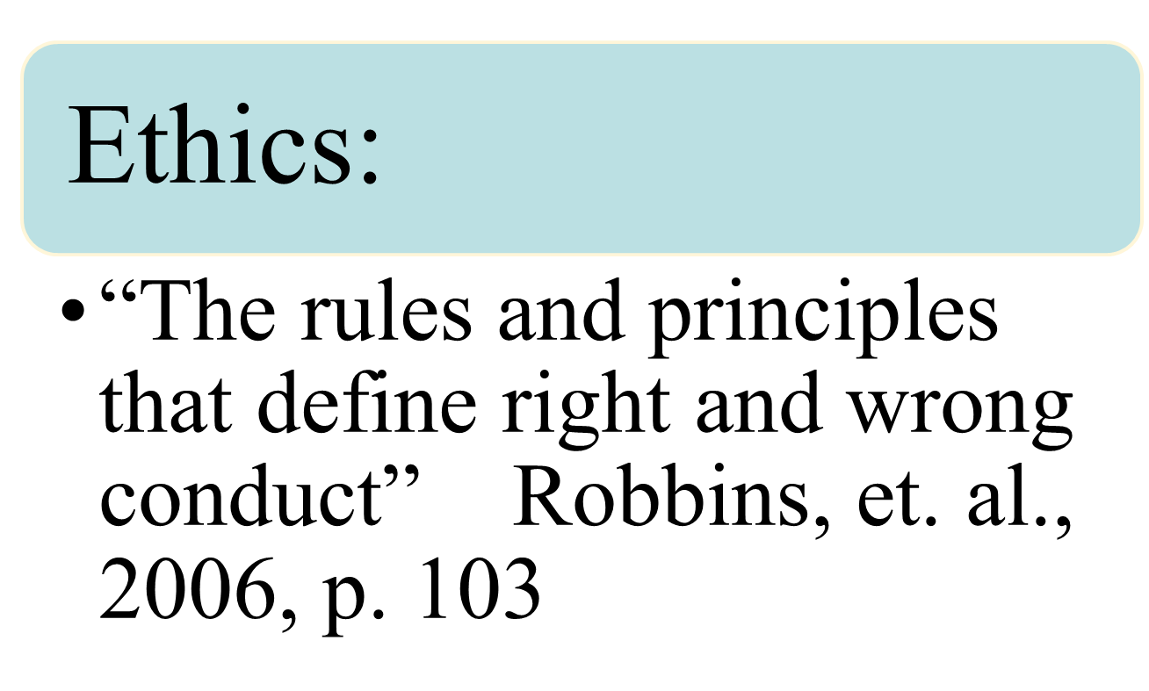
Managerial Ethics
Notes:
Recent corporate scandals including Enron, WorldCom, Tyco, and ImClone may cause many to conclude that corporate America has no ethics. The term ethics refers to rules and principles that define right and wrong conduct.
Four Views of Ethics
1. Utilitarian view of ethics says that ethical decisions are made solely on the basis of their outcomes or consequences.
2. Rights view of ethics is concerned with respecting and protecting individual liberties and privileges such as the rights to privacy, free speech, and due process.
3. Theory of justice view of ethics is where managers impose and enforce rules fairly and impartially and do so by following all legal rules and regulations.
4. Integrative social contracts theory proposes that ethical decisions be based on existing ethical norms in industries and communities in determining what constitutes right and wrong.

Slide 7

Individual characteristics
Organizational Structure
Organizational culture
Issue intensity
Chapter 4, Stephen P. Robbins, Mary Coulter, and Nancy Langton, Management, Eighth Canadian Edition.
Copyright © 2005 Pearson Education Canada Inc.
Notes:
1. Stages of Moral Development. Research confirms three levels of moral development (see Exhibit 4.6). Each level has two stages.
First level is preconventional. Person’s choice based on personal consequences involved.
b. Conventional level indicates that moral values reside in maintaining expected standards.
c. Principled level has individuals make a clear effort to define moral principles apart for the authority of the groups to which individuals belong.

Slide 8
Exhibit 4.7 Determinants of Issue Intensity
How much agreement
is there that this
action is wrong?
How many people
How likely is it
will be harmed?
that this action
will cause harm?
Consensus
of Wrong
Greatness
Probability
of Harm
of Harm
Issue Intensity
Concentration
Immediacy of
of Effect
Consequences
Proximity to
How concentrated
Victim(s)
Will harm be felt
is the effect of the
immediately?
action on the victim(s)?
How close are the
potential victims?
Chapter 4, Stephen P. Robbins, Mary Coulter, and Nancy Langton, Management, Eighth Canadian Edition.
Copyright © 2005 Pearson Education Canada Inc.
Notes:
5. Finally, the intensity of an issue can affect ethical decisions. There are six characteristics that determine issue intensity (see Exhibit 4.7).
a. Greatness of harm
b. Consensus of wrong
c. Probability of harm
d. Immediacy of consequences
e. Proximity to victim
f. Concentration of effect
According to these guidelines, the larger the number of people harmed, the more agreement that the action is wrong, the greater the likelihood that the action will cause harm, the more immediately that the consequences of the action will be felt, the closer the person feels to the victim(s), and the more concentrated the effect of the action on the victim(s), the greater the issue intensity. The more intense an issue is, the more we should expect employees to behave ethically.

Slide 9

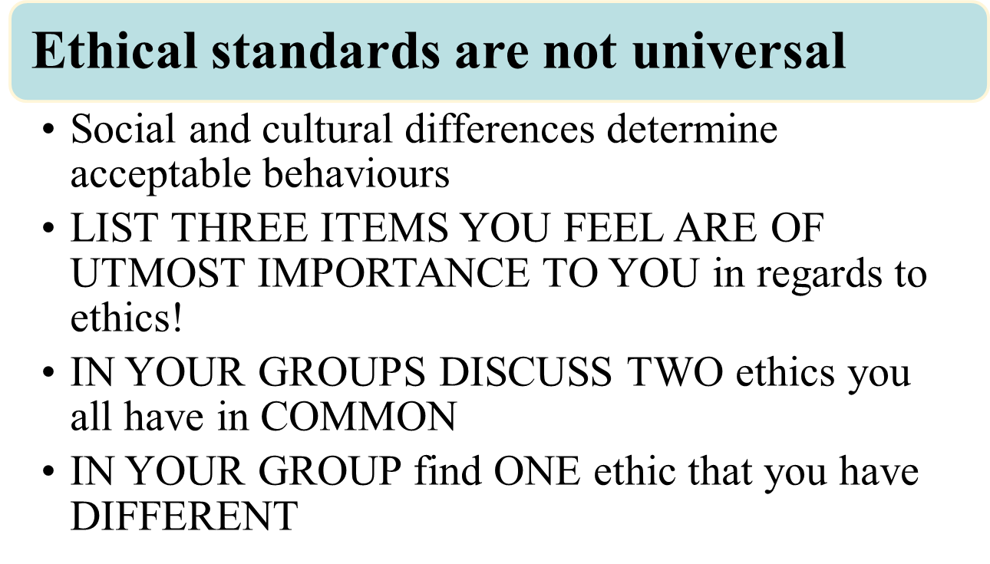
Chapter 4, Stephen P. Robbins, Mary Coulter, and Nancy Langton, Management, Eighth Canadian Edition.
Copyright © 2005 Pearson Education Canada Inc.
Notes:
Are ethical standards universal? Hardly! Social and cultural differences between countries are important environmental factors that determine ethical and unethical behaviour.

Slide 10
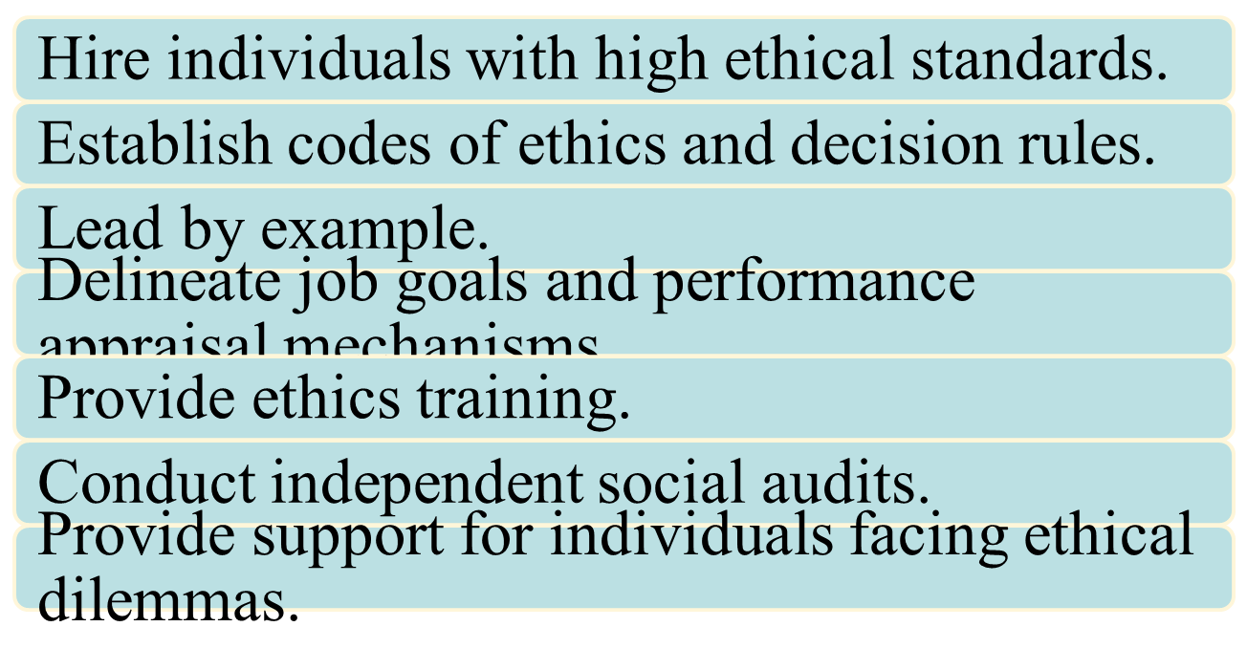
How Managers Can Improve Ethical Behaviour in an Organization
Chapter 4, Stephen P. Robbins, Mary Coulter, and Nancy Langton, Management, Eighth Canadian Edition.
Copyright © 2005 Pearson Education Canada Inc.
Notes:
1. The selection process for bringing new employees into organizations should be viewed as an opportunity to learn about an individual’s level of moral development, personal values, ego strength, and locus of control.
2. A code of ethics is a formal statement of an organization’s primary values and the ethical rules it expects employees to follow.
Ethical leadership is also an important element in fostering ethical behaviour. Top management’s leadership and commitment to ethical behaviour is extremely important because it’s the top managers who set the cultural tone.
4. Employees’ job goals should be tangible and realistic, because when goals are clear and realistic, they reduce ambiguity and motivate rather than punish. Job goals are usually a key issue in performance appraisal. If an organization wants its employees to uphold high ethical standards, it must include this dimension in its appraisal process. Performance appraisals should be comprehensive and not just focus on economic outcomes.
5. Ethics training should be used to help teach ethical problem solving and to present simulations of ethical situations that might arise. If it does nothing else, ethics training should increase awareness of ethical issues
6. Independent social audits evaluate decisions and management practices in terms of the organization’s code of ethics and can be used to deter unethical behaviour.
7. Finally, organizations can provide formal protective mechanisms so that employees with ethical dilemmas can do something about them without fear of reprisal. “Whistle-blowers” can be a key part of a company’s ethics program because they are willing to step forward and expose unethical behaviour, no matter what the cost professionally or personally. The company must limit these potential negative effects.

Slide 11
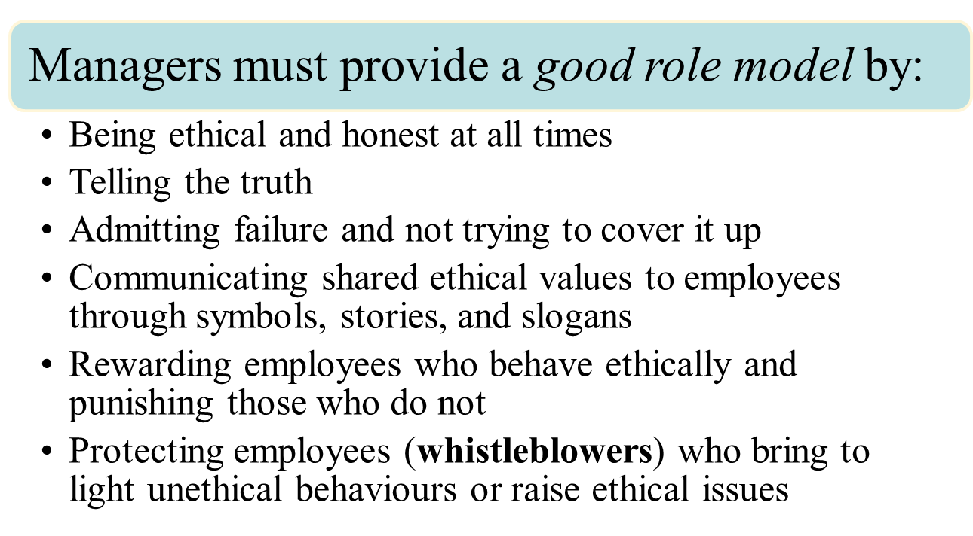
Ethical Leadership
Chapter 4, Stephen P. Robbins, Mary Coulter, and Nancy Langton, Management, Eighth Canadian Edition.
Copyright © 2005 Pearson Education Canada Inc.
Notes:
Ethical leadership is also an important element in fostering ethical behaviour. Top management’s leadership and commitment to ethical behaviour is extremely important because it’s the top managers who set the cultural tone.

Slide 12
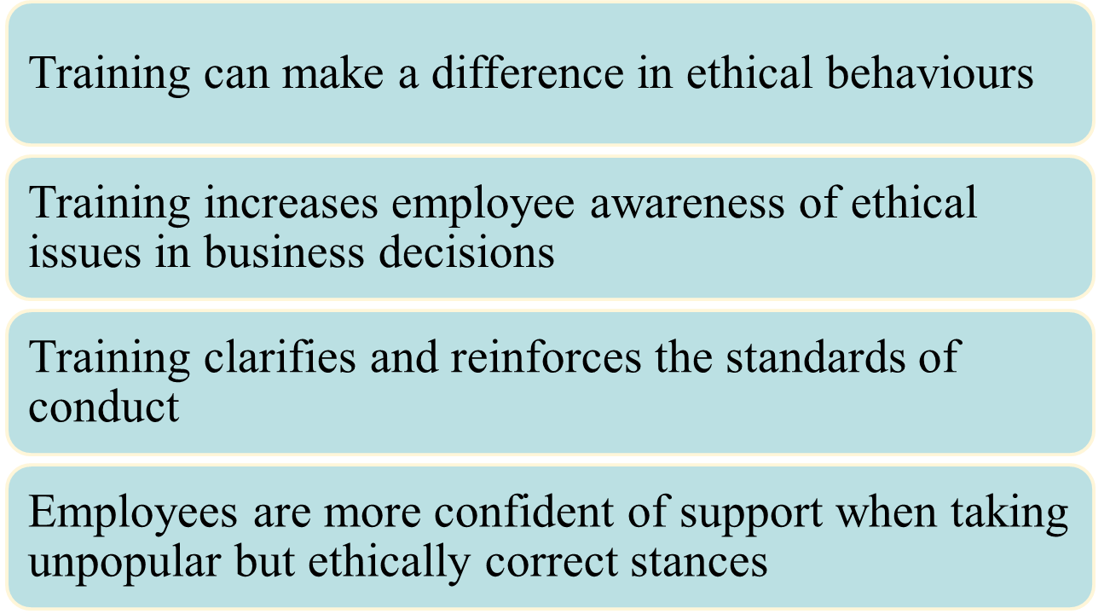
The Value of Ethics Training
Chapter 4, Stephen P. Robbins, Mary Coulter, and Nancy Langton, Management, Eighth Canadian Edition.
Copyright © 2005 Pearson Education Canada Inc.

